Slide 1
Connect to the cloud
IOT Course
Vijay Janapa Reddi
Intel (UT Austin)

Slide 2
Goals
Review
Networking
Communication
Cloud
Data sharing

Slide 3
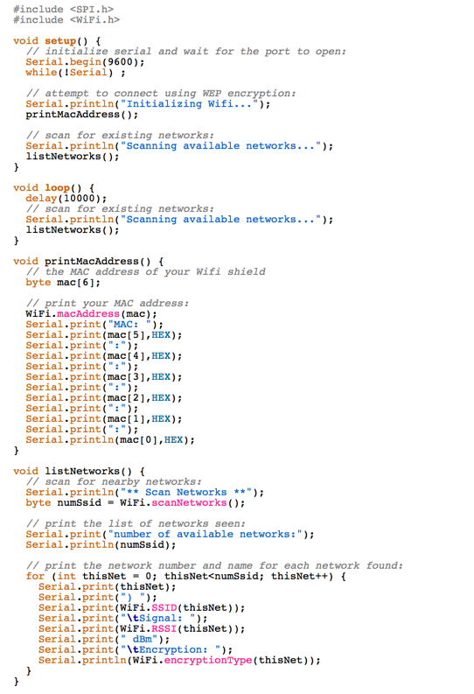
Connect to the Cloud!

Slide 4
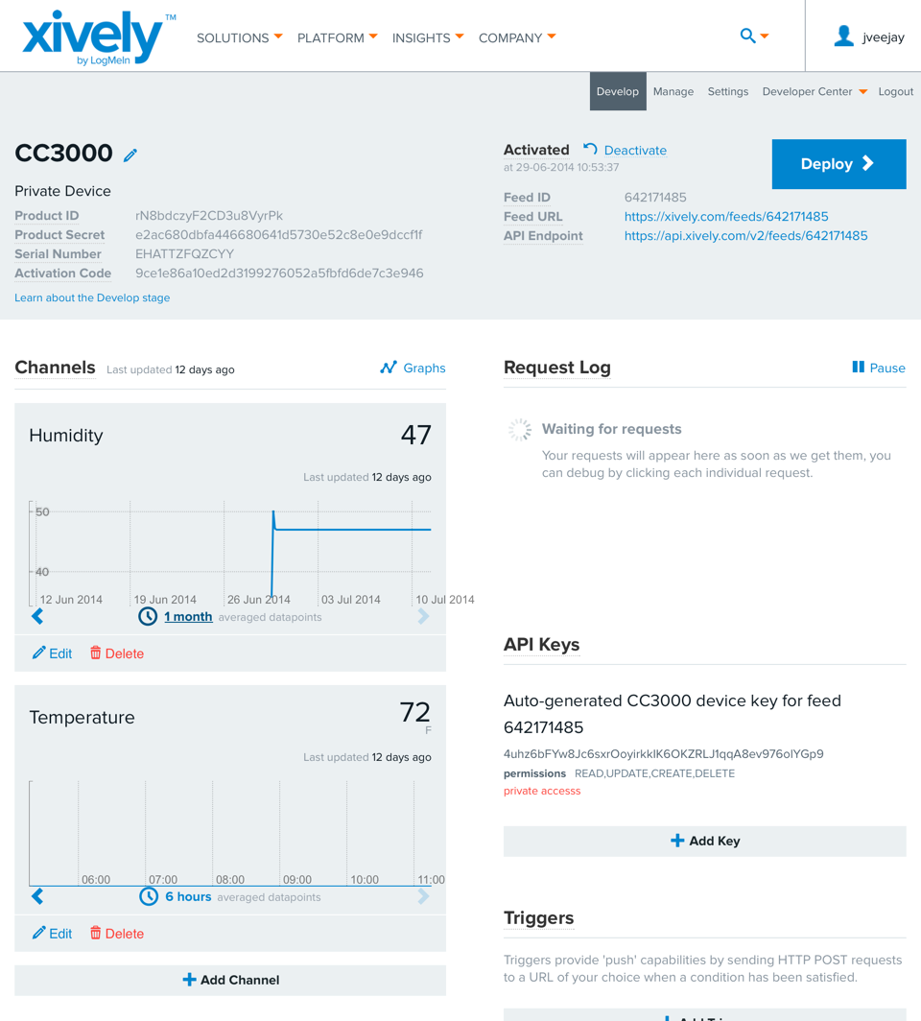
Connect to the Cloud!

Slide 5
Xively Cloud Services
Supports hundreds of platforms, millions of gateways and a crazy number of smart devices
Comprehensive and secure infrastructure services
Online development tools and dev center

Slide 6
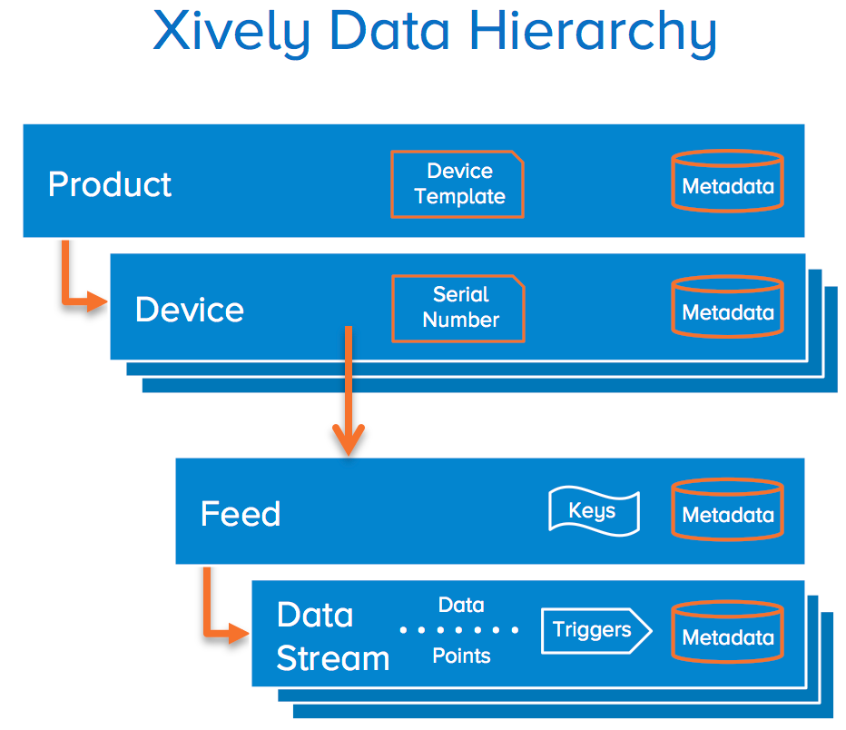

Slide 7
Xively
Feed ID
Channels
API Keys
Triggers

Slide 8
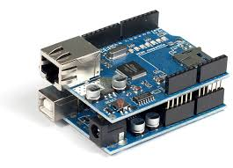
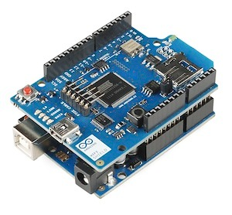
Connect an Arduino to Xively

Slide 9
Hooking up a Photocell

Slide 10
... // assume global variables here and setup() for Ethernet (as we saw earlier)
void loop() {
. . .
// if you're not connected, and ten seconds have passed since
// your last connection, then connect again and send data:
if(!client.connected() && (millis() - lastConnectionTime > postingInterval)) {
sendData(sensorReading);
}
}
. . .

Slide 11
// this method makes a HTTP connection to the server:
void sendData(int thisData) {
// if there's a successful connection:
if (client.connect(server, 80)) {
Serial.println("connecting...");
// send the HTTP PUT request:
client.print("PUT /v2/feeds/");
client.print(FEEDID);
client.println(".csv HTTP/1.1");
client.println("Host: api.xively.com");
client.print("X-XivelyApiKey: ");
client.println(APIKEY);
client.print("User-Agent: ");
client.println(USERAGENT);
client.print("Content-Length: ");
// calculate the length of the sensor reading in bytes:
// 8 bytes for "sensor1," + number of digits of the data:
int thisLength = 8 + getLength(thisData);
client.println(thisLength);
// last pieces of the HTTP PUT request:
client.println("Content-Type: text/csv");
client.println("Connection: close");
client.println();
// here's the actual content of the PUT request:
client.print("sensor1,");
client.println(thisData);
}
else {
// if you couldn't make a connection:
Serial.println("connection failed");
Serial.println();
Serial.println("disconnecting.");
client.stop();
}
// note the time that the connection was made or attempted:
lastConnectionTime = millis();
}
Easy way, using REST

Slide 12
#include <SPI.h>
#include <WiFi.h>
#include <HttpClient.h>
#include <Xively.h>
char ssid[] = "SSID_HERE"; // your network SSID
char pass[] = "PASS_HERE"; // your network password
int status = WL_IDLE_STATUS;
char xivelyKey[] = "API_KEY_HERE";
#define xivelyFeed FEED_ID_HERE
char sensorID[] = "LIGHT_SENSOR_CHANNEL";
char ledID[] = "LED_CHANNEL";
// Analog pin which we're monitoring
#define sensorPin A2
//led connected pin
#define ledPin 9
// Define the strings for our datastream IDs
XivelyDatastream datastreams[] = {
XivelyDatastream(sensorID, strlen(sensorID), DATASTREAM_FLOAT),
XivelyDatastream(ledID, strlen(ledID), DATASTREAM_FLOAT),
};
// Finally, wrap the datastreams into a feed
XivelyFeed feed(xivelyFeed, datastreams, 2 /* # datastreams */);
WiFiClient client;
XivelyClient xivelyclient(client);
. . .
Way faster, using Sockets
see next slide for cont.

Slide 13
#include <SPI.h>
#include <WiFi.h>
#include <HttpClient.h>
#include <Xively.h>
char ssid[] = "SSID_HERE"; // your network SSID
char pass[] = "PASS_HERE"; // your network password
int status = WL_IDLE_STATUS;
char xivelyKey[] = "API_KEY_HERE";
#define xivelyFeed FEED_ID_HERE
char sensorID[] = "LIGHT_SENSOR_CHANNEL";
char ledID[] = "LED_CHANNEL";
// Analog pin which we're monitoring
#define sensorPin A2
//led connected pin
#define ledPin 9
// Define the strings for our datastream IDs
XivelyDatastream datastreams[] = {
XivelyDatastream(sensorID, strlen(sensorID), DATASTREAM_FLOAT),
XivelyDatastream(ledID, strlen(ledID), DATASTREAM_FLOAT),
};
// Finally, wrap the datastreams into a feed
XivelyFeed feed(xivelyFeed, datastreams, 2 /* # datastreams */);
WiFiClient client;
XivelyClient xivelyclient(client);
. . .
void loop() {
//adjust LED level. set from Xively
int getReturn = xivelyclient.get(feed, xivelyKey);
if(getReturn > 0){
Serial.println("LED Datastream");
Serial.println(feed[1]);
} else Serial.println("HTTP Error");
//write value to LED - change brightness
int level = feed[1].getFloat();
if(level < 0){
level = 0;
}else if(level > 255){
level = 255;
}
//actually write the value
digitalWrite(ledPin, level);
///////////////////////////////////////////////////////
//read sensor values
int sensorValue = analogRead(sensorPin);
datastreams[0].setFloat(sensorValue);
//print the sensor valye
Serial.print("Read sensor value ");
Serial.println(datastreams[0].getFloat());
//send value to xively
Serial.println("Uploading it to Xively");
int ret = xivelyclient.put(feed, xivelyKey);
//return message
Serial.print("xivelyclient.put returned ");
Serial.println(ret);
Serial.println("");
//delay between calls
delay(15000);
}
Way faster, using Sockets

Slide 14
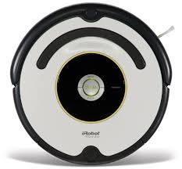
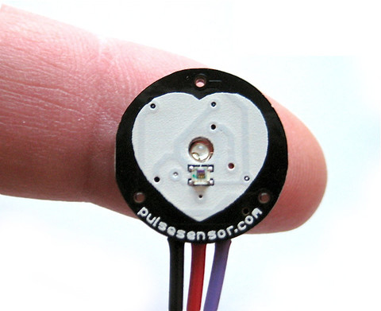
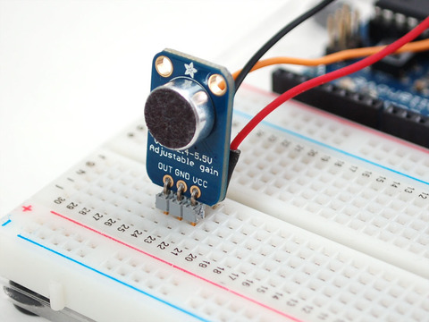
Awesome – So What?!
?

Slide 15
“WebTasks”

Slide 16
Data-triggered “WebTask” Automation
triggers

Slide 17
Connection Services
Google Docs
Amazon Web Services
Xively
Facebook
Twitter
Flickr
Google Maps
…

Slide 18
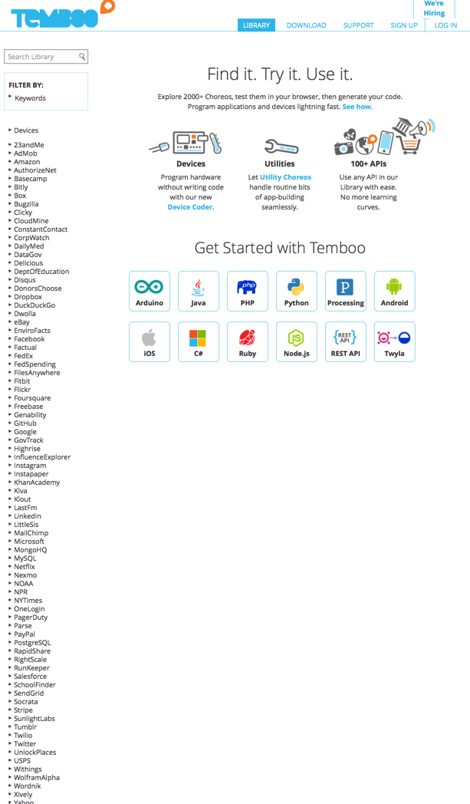
Automatically generates code
Choreos
Streamline the arduous processes for everyday programming tasks
Lots of “choreos”
2,000+

Slide 19
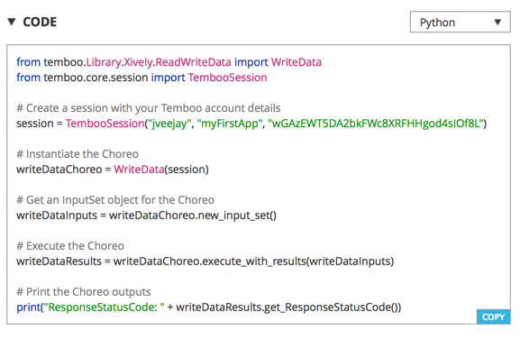
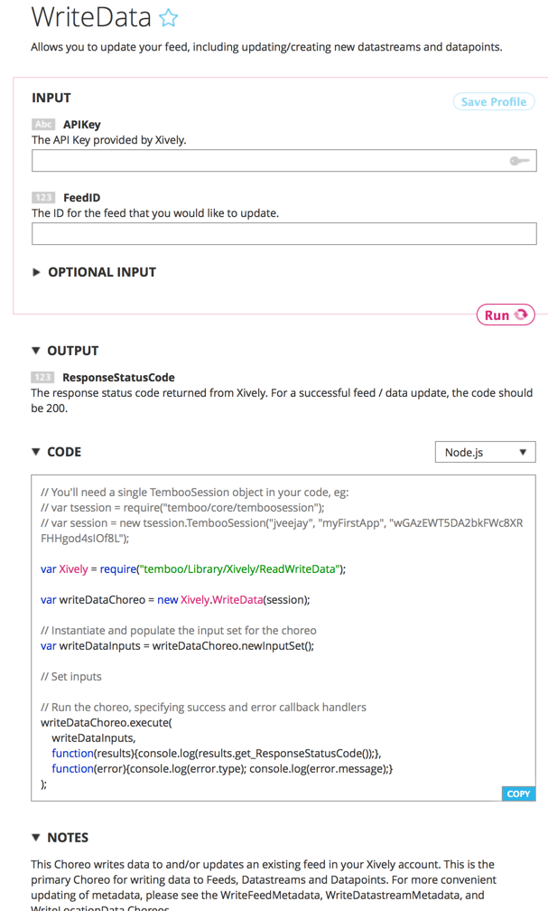
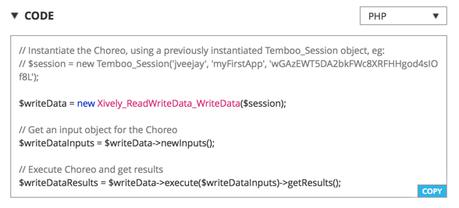

Slide 20
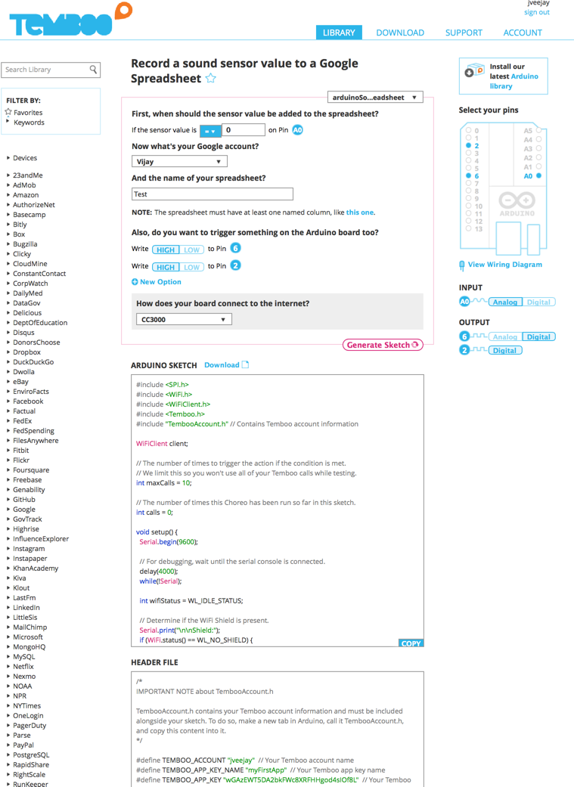

Slide 21
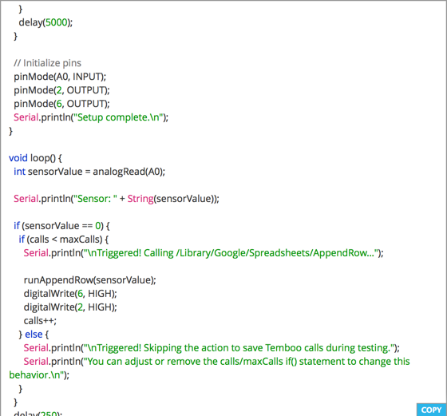
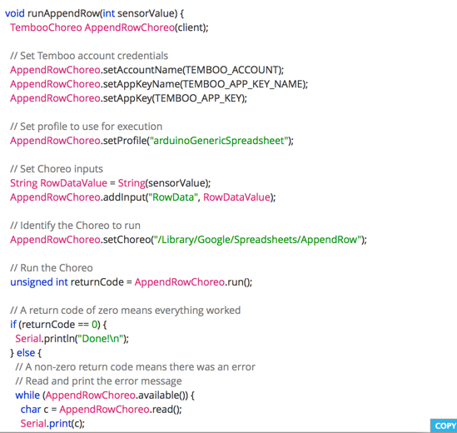

Slide 22
“Find it. Try it. Use it.”

Slide 23
